Slide 1
Wednesday Update Better Together: Text + Context
Kenneth Church
Wed, July 5
https://github.com/kwchurch/JSALT_Better_Together

Slide 2
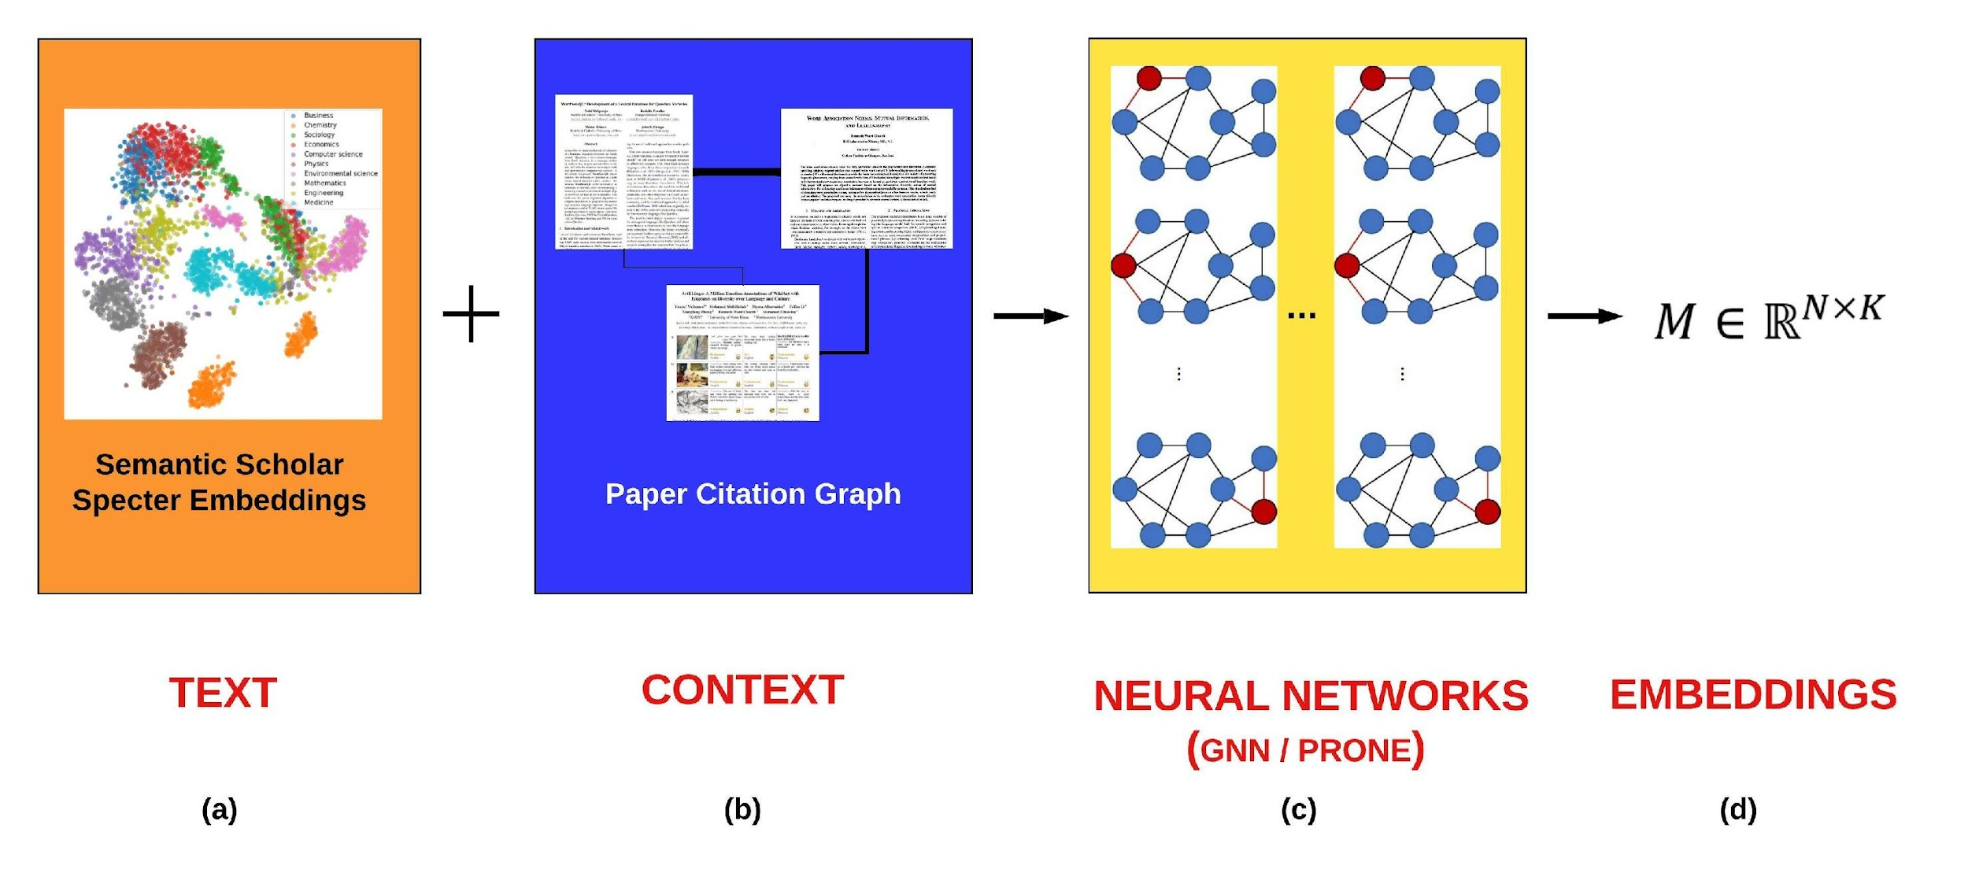
Better Together: Text (Titles, Abstracts, Body); Context (Citations)

Slide 3
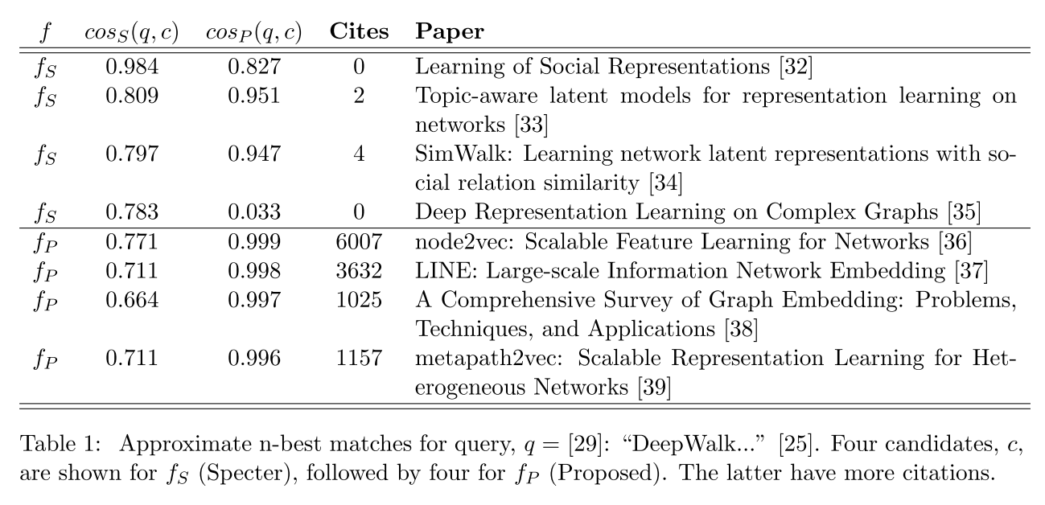
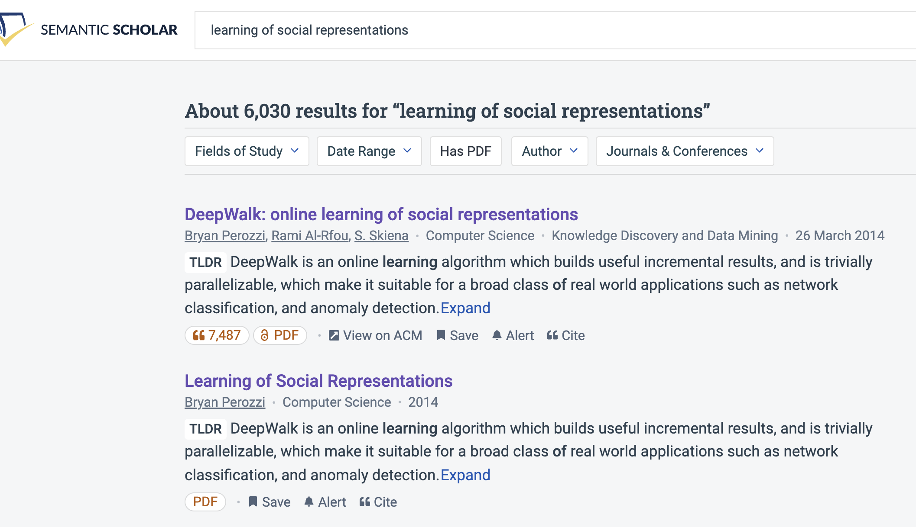
Query: ``DeepWalk: Online Learning of…’’

Slide 4
Document Similarities: Use Cases
Recommendations
What should I read?
What should I cite?
Many systems focus on ``relevance’’ (word overlap)
But don’t recommend dups
Moreover, credibility is super-important
Don’t recommend papers that are buzz-word compliant
But not worth reading
(Most papers are never cited)

Slide 5
Realities
The Real World
Idealizations (Evaluation Benchmarks)
Large
Growing
Dirty
Missing Values
Bad/misleading Values
Small
Static
Clean

Slide 6
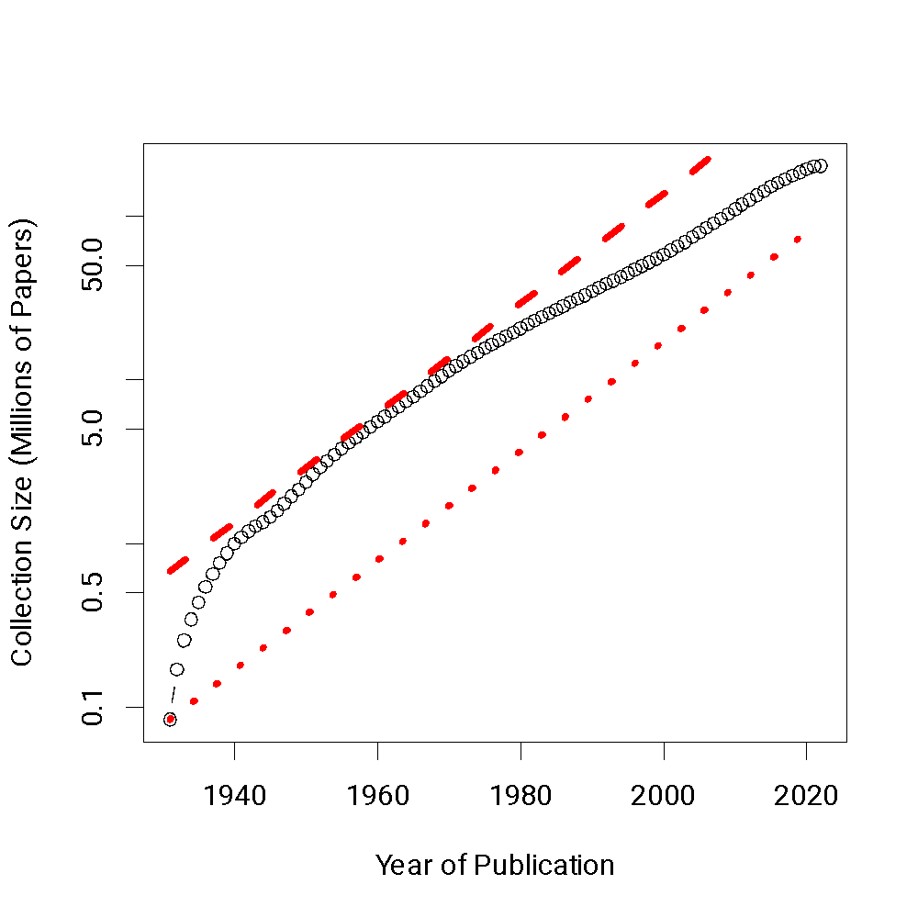
Global Scientific Output Doubles Every 9 Years
Timeliness
Web companies keep indexes up to date (web is a moving target)
Ditto for Academic Search

Slide 7
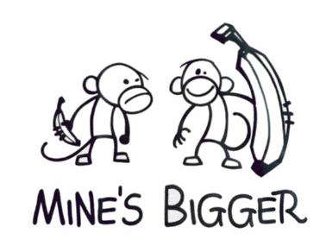

Opportunity for Evaluation: Answer Important Questions
Unimportant Questions (SOTA-Chasing)
Important Questions (Good)
Mine is bigger than yours
What should I read? Cite?
What’s Hot & What’s Not?
Which papers are
tearing up the charts?
Which authors are
rising stars
Timeliness (Update Story)
Post model on HuggingFace
COVID happens
How long are models good for?
Sell-by dates for SciBERT

Slide 8
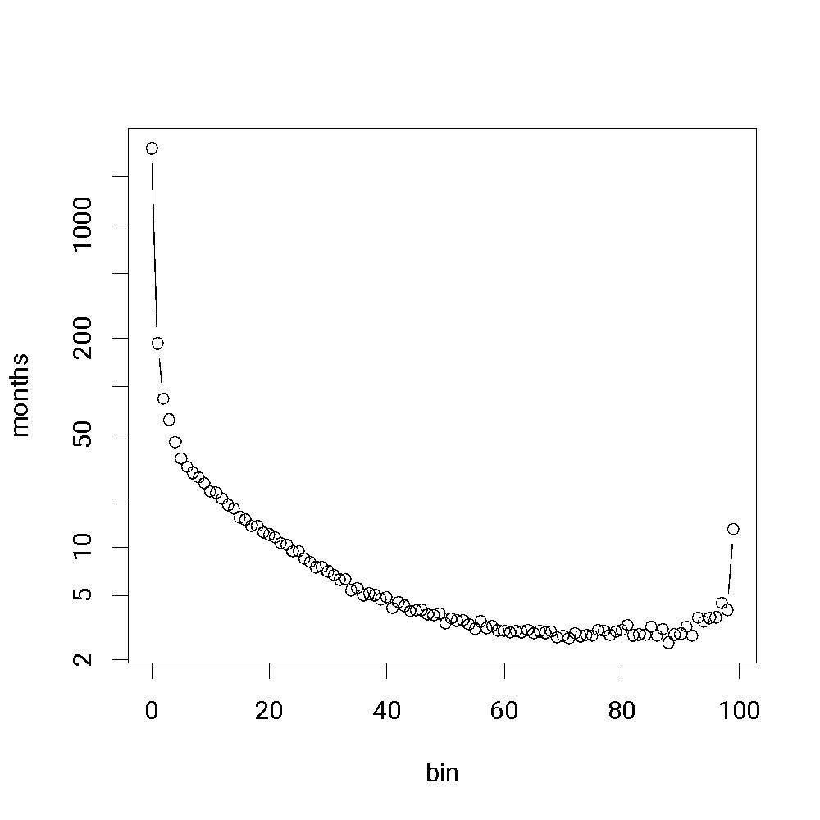
Standard Test-Train Split Assumes Time is Symmetric
It is difficult to make predictions, especially about the future.
-- Yogi Berra
bin | date
0 | 1684-05
1 | 1936-03
2 | 1951-08
3 | 1958-08
4 | 1963-10
5 | 1967-07
6 | 1970-06
7 | 1973-01
8 | 1975-07
9 | 1977-10
Proposed Split
Sort 200M papers by pub date
Create 100 bins
2M papers per bin
Train on early bins
Test on later bins
Hypo:
Short-term weather forecasting
is easier than long-time forecasting

Slide 9
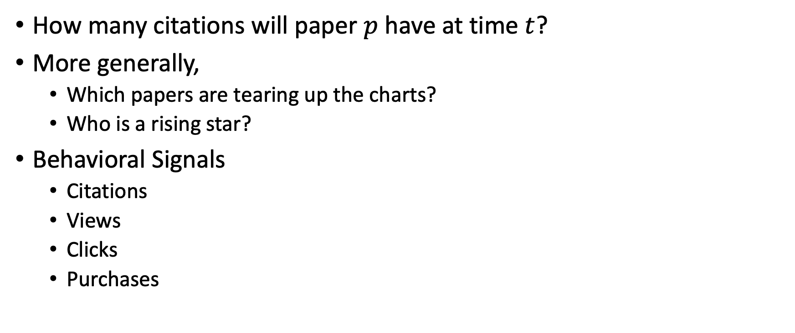
Simple Question: Predicting Audience Appreciation

Slide 10
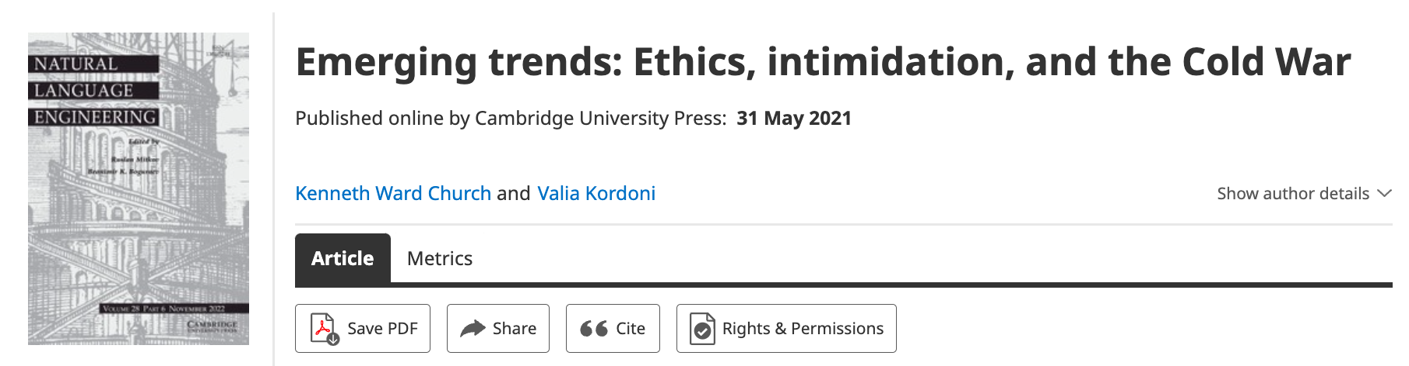
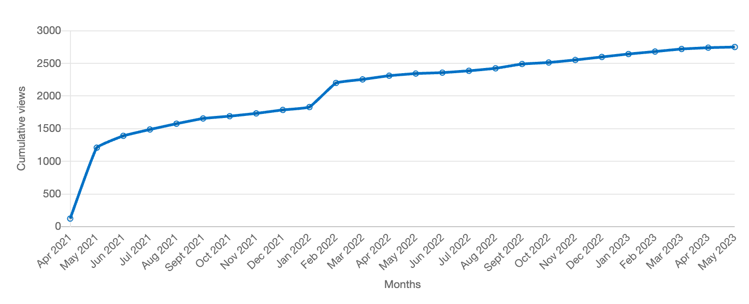
Value: Author Contributions + Audience Appreciation (Literature is a conversation, like social media)
Author Contributions
Time Invariant
Does not change after publication
Audience Appreciation
Evolves over time
Behavioral Signals
Views
Citations
It is difficult to make predictions, especially about the future.
-- Yogi Berra

Slide 11
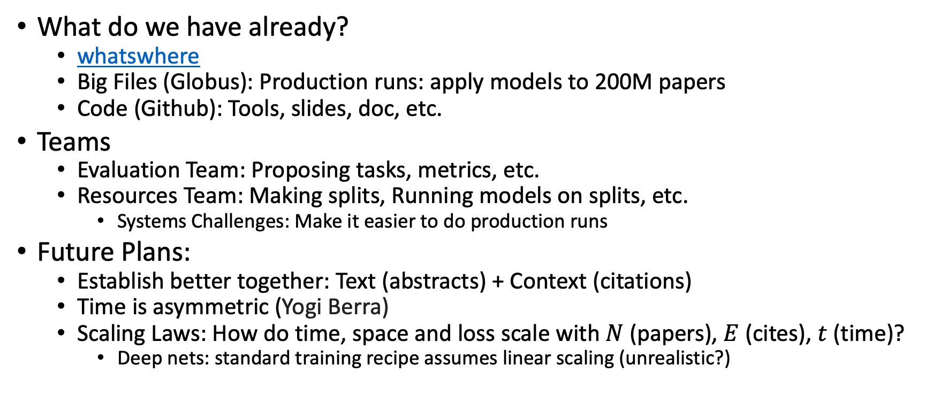
Where are we? And where are we going?

Slide 12
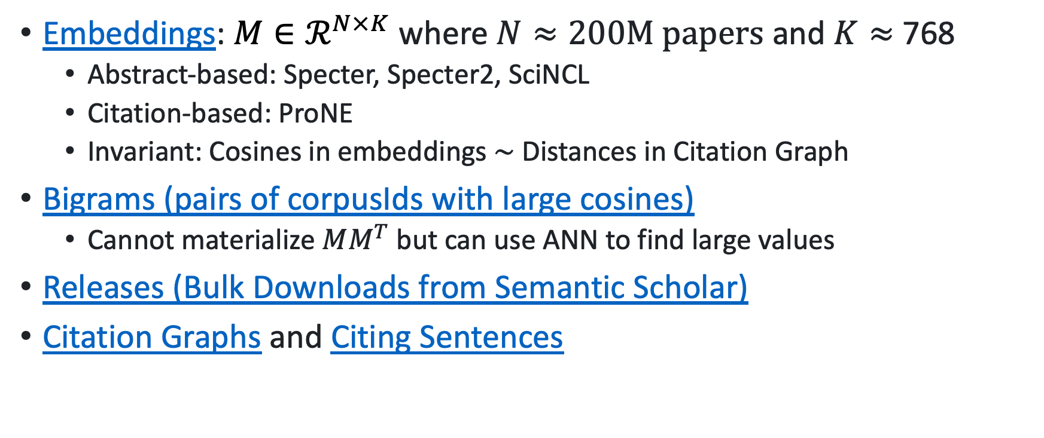
What do we have? Big Files on Globus

Slide 13
Deliverables https://github.com/kwchurch/JSALT_Better_Together/blob/main/doc/deliverables.md
Better access to literature
Resources:
Many embeddings for many papers
Posted models on HuggingFace
Post code on GitHub
Summarization methods to compare and contrast across small (and large) collections of documents
Support incremental updates to embeddings based on citation graphs
Evaluation:
Better numbers,
as well as better benchmarks
Establish that combinations of text and links are better together (than either by itself)
Establish that citing sentences are useful
Improve methods for assigning papers to reviewers
Theory: Unified framework of
Deep nets and
Linear Algebra
Bibliometrics:
Predict citations of a paper over time.
Predict h-index of an author over time.
Find authors that publish too many papers

Slide 14
Better Together Evaluation
05/07/2023

Slide 15
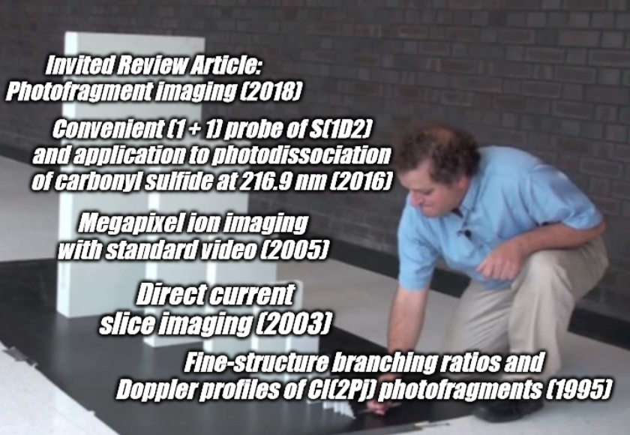
Train-Test on a Graph
Typical ML approach is randomly partition test and train data
However, with temporal data we must have a sense of cause and effect: any referenced paper should be considered ‘seen’
Partition and evaluate accordingly

Slide 16
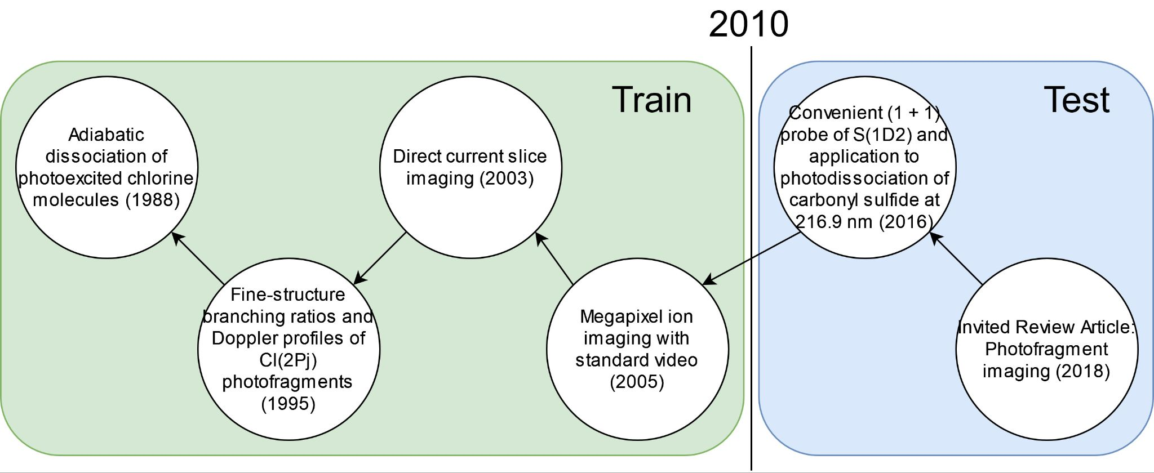
Partitioning a Graph for Train-Test
Partition the graph into test and train by a date
But things are messy..
All before are valid for training, everything afterwards is unseen to the model
Can train on the graph, on the text, on other attributes (author, year, venue)
Notes:
No asymmetry of time - how to reduce to a soundbite
Audience soundbites
‘Almost all studies in ml do test-train split’ that’s a bad idea when you have time

Slide 17
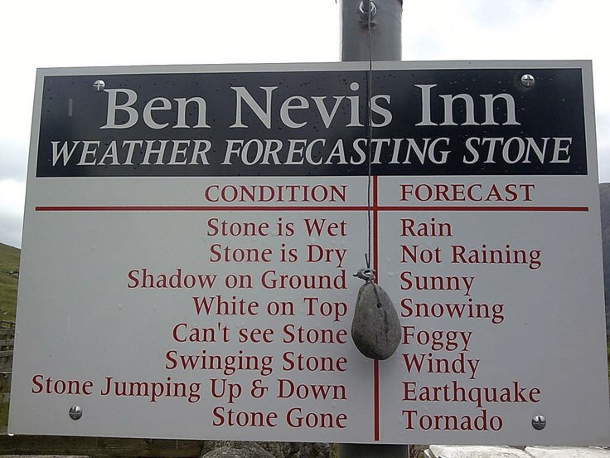
Forecasting
Make correct predictions repeatedly across a reasonable amount of time
Not interesting to ‘forecast’ into the past or the present
Deployed models typically have frozen parameters. Therefore they are always forecasting

Slide 18
Pitfalls with Evaluating Paper Systems
Evaluating within the Train set time: artificially easy (when we write papers, we can’t see what will be published in the future), introduces leakage
Tasks artificially simplified: Citation recommendation tasks propose negatives as those papers with a restricted training set (1K-100K). In reality, the number of negatives is closer to 100M.
Small data sets: Some tasks may have as few as 30 samples, which is not enough to differentiate between systems with different capabilities
Notes:
Notes from Ken:
Record myself on zoom call and measure how much time to spend on each slide. >2 slides
Provide some memes and keep things snappy

Slide 19
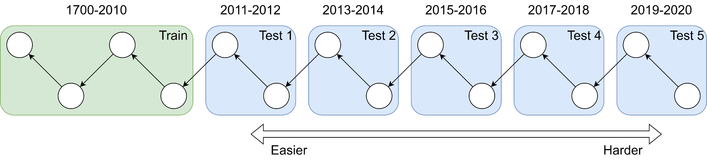
Forecasting
We have an intuition that Test 1 will be the easiest, as academic literature evolves over time
How can we evaluate this shift:
Intrinsic evaluation: what's going on in the models
Task performance: how well do the
We want to produce a set of tasks which:
Have enough samples (n) to make serious comparisons between models. Make datasets as big as possible
Evaluate models capabilities to do tasks people actually care about
Ensure generation is automatic so we can update them in future

Slide 20
Better Together Tasks
Citation Recommendation - the paradigmatic Better Together task - What does Paper A reference?
Simple implementation: get Paper A vector representation with model M and retrieve the nearest papers
Can also make Citation Recommendation local: given a sentence in Paper A predict that reference.
Many valencies around features, number of negatives, scoring (classification vs retrieval)
Example: How do Dogs Walk?
Erroneous Quadruped Walking Depictions, Horváth et al (2009)
“Although humans have observed walking quadrupeds for thousands of years, the exact characterization of the walking of tetrapods had to wait for the advent of photography [?]”
Task: Find a reference to a (History of Science) paper describing the process of photographing tetrapod walking
Notes:
Thesis: it will be harder to do Citation Recommendation as Paper A is chosen further forward in time due to citation graph evolution and academic topic development

Slide 21
Other Evaluations
Citations after k Years - How many citations did Paper A have after k years?
‘Hit Prediction’, that is, will a paper be successful.
More specifically we ask ‘will the model be ‘a hit’ at a specific time, which is relevant to academic literature as certain topics wax and wane in terms of field attention.
Repeat References - Given A references B, how many times does it reference B?
Agnostic about what multiple references means, but it probably means something
Publication Year - What year is paper A published?
Is a paper timely? Is the model capable of inferring time from the (messy) citation graph
Venue Prediction - Which venue is paper A published in?
Helpful to users: I’ve written a paper in a new area for me, where do I send it?
Peer Reviewer Score - What score was this paper given on OpenReview?
Very hard, potentially aleatory uncertainty in the reviewing process (what did reviewer 2 have for breakfast?) but powerful

Slide 22
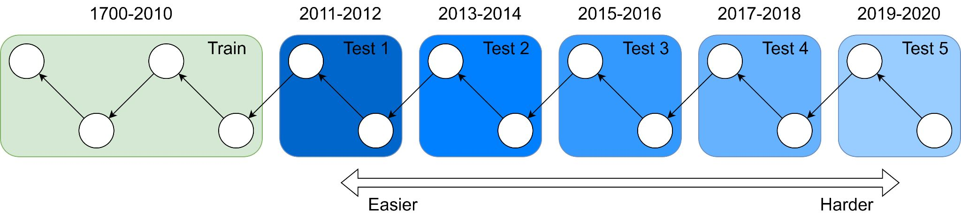
Evaluating Models
Don’t just do these evaluations, see how they perform as time from cutoff year increases.
Intuition: as we try these tasks further out, things get muddier. If you’re an expert in 2010 what do you know about COVID, AlphaGo, South Sudan, etc?
Question: How to quantify this?
LLM: Perplexity of SciBERT across different bins, BPE compressibility
Better Together Eval: task performance at y+1, y+2, y+n (up to 2023*)

